Slide 1
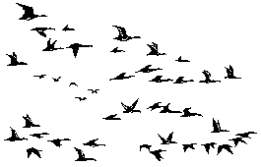
VA EHRM Data Migration: VX130 – Bulk Data Loads and Continuous Synchronization Across VA
Nov 28, 2018
Augie Turano PhD
Notes:
http://www.stampscapes.com/animals.html

Slide 2
Data Migration Objectives
Migrate key VA clinical, administrative, and financial data to Cerner in support of the Electronic Health Record Modernization (EHRM) effort to ensure the right data is available at the right time for Point of Care.
WHAT
To migrate VistA data directly from the 130 VistAs , identified and prioritized by the Clinical Councils, to Cerner HealtheIntent API (VA Responsibility), then to HealtheIntent and subsequently to the Millennium (Cerner Responsibility) EHR prior to IOC.
All VistA data domains identified for IOC will be migrated to HealtheIntent. A portion of that data will be identified by the clinical councils to make up the longitudinal health record.
Not all longitudinal health record data will be migrated to Millennium; the clinical councils will determine what data is migrated into Millennium.

Slide 3
Data Migration Objectives
HOW
Leverage a proven tool and process to extract data directly from the consolidated VistAs into our data migration tool named the VX130.
Provide Meta Data Packages that contain all the information that Cerner will require to map the data into Cerner HealtheIntent and Millennium.
WHEN
All identified and prioritized domains are scheduled to be loaded into HealtheIntent 12 months after contract sign.

Slide 4
Domain Migration Tracker

Slide 5
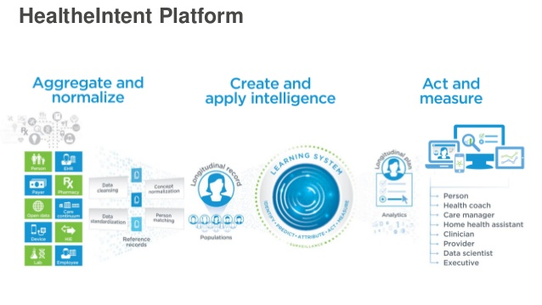
Cerner HealtheIntent
5
5

Slide 6
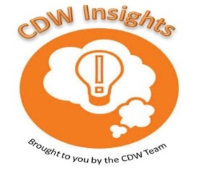
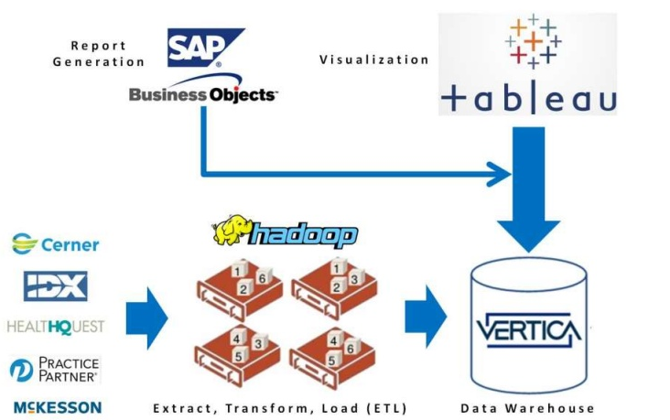
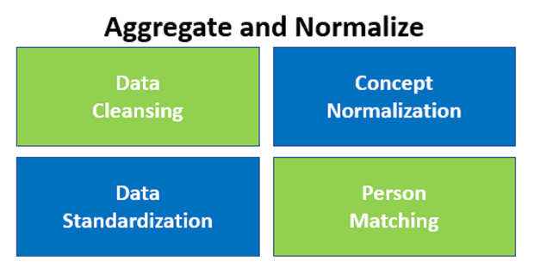
Movement of VistA Data to
Cerner EDW Infrastructure
VX130 Mirror System
VistA data is pushed from the VX130 Mirror System in Kansas City into
HealtheIntent, where it is aggregated and normalized for use in
other components of the Cerner EDW infrastructure
6
6
6
6

Slide 7
Data Hunt?
Where Might Data Be –
VistA – 10-year implementation cycle for Cerner
HealtheIntent – Long data record similar to DW
Millennium - EHR – possibly writebacks to CDW
Private care – physicians office, ACO, Private hospitals, etc.
Analysis could be –
HealtheIntent->EDW (Vertica)
National Laboratory like Oak Ridge
Azure Cloud
VINCI

Slide 8
Building the Caché Class
Leverage existing CDW Processes (but NOT CDW)
Files and fields modeled and in CDW production database.
Enhancements have been added to the CDW Processes for the unique needs and requirements of OEHRM.
Thus, Creating the….
VX130 Data Modeling Process
Evaluate VistA file structure
Fields, data types, descriptions
Sub-files that need to be included
Pointer files that need to be included
VistA Data types changed to SQL data types
Field names updated to conventions
Inherit fields from parent or through pointers

Slide 9
Building the Caché Class
VX130 Data Modeling Process, Cont.
Creates a set of instructions for an application called ClassBuilder which is used to create a “Class”.
Classes use VistA globals but in an InterSystems object format to store the data.
Classes are like pathways to help determine what data to extract from VistA and which fields are used to display the VistA field values in the SQL table.
Classes give you the ability to use SQL to query data instead of writing M code.

Slide 10
Building the Caché Class
VX130 Data Modeling Process, Cont.
Architect creates a mock-up of the SQL table.
Uses ClassBuilder to build the modeled class.
Tests the class by pulling a sample and populating the SQL table.
Architect checks the data in SQL to see if fields’ data types are populating correctly between extract and SQL table.

Slide 11
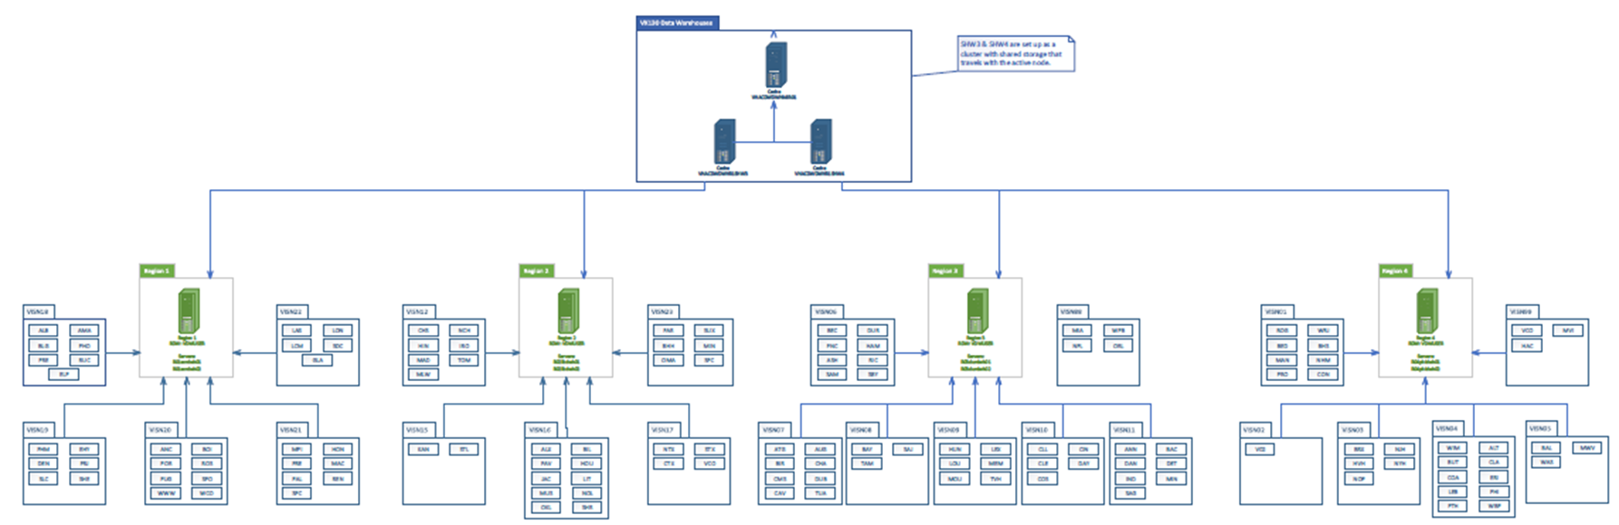
VX130 VA-Side Architecture
Four Regional Servers accumulate journals
VX130 reads journals from Regional Servers but goes to VistA for data retrieval

Slide 12





EHRM Data Migration Overview
Austin, TX
Kansas City, MO
TO
VistA Globals
Caché Class
Class Table
Relational Output
Centralized VistA Shadows
Data Extract and Aggregation Solution
Cerner HealtheIntent
VistA-R1
N=33
VistA-R1
N=33
Journal Reader & VistA data extracted
Active Population Bundle Generation
Data Bundles
Caché Classes &
SQL Tables are created
Ingestion Service
API
Data Migration
Service
VistA-R2
N=29
Objects & Records
are updated
VA
Data
All patients,
All history
Active patients,
Partial history
VISTA REGIONS
Data Check
VistA Shadow System
Vista consistency check
InterSystems
Interface Engine
VistA-R3
N=41
Historical Data
Cerner Millennium
EHR
VX130 System
Near Real-Time Synchronization
VX130 Mirror System
VistA-R4
N=27
Caché
Caché
Initial
Data
Domains
TO
From
VistA → VistA Shadows → VA VistA Globals → Caché Objects → VX130 Caché DB → VX130 Caché Mirror → HealtheIntent → Millennium
To

Slide 13
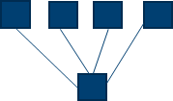


VX130 Data Flow
VAMCS
VistA FileMan Data (Globals)
Regional Servers
Journals
VX130
Journal Readers
Data Filers
Caché Class Models
Data
FDW
AITC
DB
DB
DB
DB
DB
DB
Mirror All Classes
WAN
Cerner
Mirror
DB
DB
DB
DB
DB
DB
Data Table Bundle Processing
Cerner
APIs
Healthe
Intent
Millennium
EHR

Slide 14
Caché Objects –> Relational Projections
Object and Relational Database Architecture
Object
-----------------------
Class
Object/Instance Properties
Methods
Relational
----------------------
Table
Tuple/Record Column/Field
Stored Proc
Currently, we use Globals in FileMan format to store data.
Classes use Globals too, but in InterSystems object format to store data.
Classes give you the ability to use SQL to query data instead of writing M code and much more.
Class Demo.MyClass Extends %Persistent
{
Property Property1 As %String;
Property Property2 As %Numeric;
Method MyMethod() As %String
{
set returnvalue=..Property1_..Property2
quit returnvalue
} }
^DD(3,.01,0)="NAME^"
^DD(3,1,0)="SEX^"
^DD(3,2,0)="DOB^"
^DD(3,3,0)="DEPARTMENT^"
^DD(3,4,0)="SKILL^"
Object
FileMan Global
^Demo.MyClassD(1)=$lb("","augie",3)
2)=$lb("","Ralph",500)
3)=$lb("","Ted",30)
Notes:
Class Demo.MyClass Extends %Persistent
{
Property Property1 As %String;
Property Property2 As %Numeric;
Method MyMethod() As %String
{
set returnvalue=..Property1_..Property2
quit returnvalue
}
Method Create()
{
set myclassoref=##class(Demo.MyClass).%New()
set myclassoref.Property1="Ted"
set myclassoref.Property2=30
do myclassoref.%Save()
quit "1"
}
Storage Default
{
<Data name="MyClassDefaultData">
<Value name="1">
<Value>%%CLASSNAME</Value>
</Value>
<Value name="2">
<Value>Property1</Value>
</Value>
<Value name="3">
<Value>Property2</Value>
</Value>
</Data>
<DataLocation>^Demo.MyClassD</DataLocation>
<DefaultData>MyClassDefaultData</DefaultData>
<IdLocation>^Demo.MyClassD</IdLocation>
<IndexLocation>^Demo.MyClassI</IndexLocation>
<StreamLocation>^Demo.MyClassS</StreamLocation>
<Type>%Library.CacheStorage</Type>
}
}

Slide 15

VX130 Characteristics
No VistA routines or patches needed.
All data dictionary changes are monitored.
Shadowed VistA systems are used as data sources; no load is put upon the live patient care machines.
Shadow systems aggregate data from many VistA instances to a single instance for processing.
CDW Data Model used to store VistA data, vetted by experts over several years.
Fields can be added or deleted in the data monitoring/extraction process. (GlobalsToWatch matches fields to global storage patterns)
Extraction Code is autogenerated based on the class/field definitions, so fields can be modified or added quickly.
Data retrieval can be done for FileMan or non-FileMan globals
A GUI view of the entire system gives an informative status of every VistA VAMC database and the connection state.

Slide 16
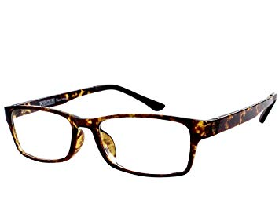
VistA Change Management
VX130 uses the journal reader mechanism to monitor changes to the VistA data dictionary at each site.
When a change is made, the corresponding record in a Caché class is updated or removed.
If a field is added, VX130 knows which field was added and when.
If a field type is changed, VX130 knows which field changed and when, as well as what the new field type is.
If a field is removed, VX130 knows which field was removed and when.
VX130 can track historical changes since yesterday, or in the last half hour, or in the last month.

Slide 17
Tracks all Changes to VistA Data Dictionary
VX130 uses the journal reader mechanism to monitor changes to the VistA data dictionary at each site.
When a change is made, the corresponding record in a Caché class is updated or removed.
If a field is added, VX130 knows which field was added and when.
If a field type is changed, VX130 knows which field changed and when, as well as what the new field type is.
If a field is removed, VX130 knows which field was removed and when.
VX130 can track changes since yesterday, or in the last half hour, or in the last month.

Slide 18
Maintains Data Element Mapping
VX130 maintains a one-to-one mapping of each and every monitored data element in an attribute map.
Each version of every table has an attribute mapping of table name/column (or class/property) to VistA file/field.
Using the attribute map and the data dictionary information, VX130 can determine exactly which tables and which columns (classes/properties) are affected by a change in the data dictionary.
Using that information VX130 can:
Re-version a new table to pick up the newly added field(s) by adding them to the attribute map. OR
Recompile (much like a compiled print template works in FileMan).

Slide 19
Tracks all Changes to Maintained Records
The journal reader process knows what globals VX130 is tracking and the characteristics of those globals.
When changes are made on the VistA system, they flow through to the shadow via the journal file and VX130 knows what records need to be checked for changes.
Whenever a change is made to a tracked data element, VX130 sets three properties of that Caché object:
VistaCreateDate – date a record is created on the VistA system.
VistaEditDate – date a record is updated or deleted on the VistA system.
OpCode – a flag that indicates if a record was deleted on the VistA system.

Slide 20
VX130 Journal File and Journal Reader Details
Journal files record Set/Kill commands on the VistA globals (Logs for VistA DB activity)
Journal readers are processes run on the Cache/Linux servers to monitor and capture the VistA journal file activity.
Constantly read the journal files and, based on the entries defined in the GlobalsToWatch table, select and put records into the data filer queue.
Four journal readers for each instance (Raw, CDW, Regions, VX130); data filers run on the VX130 instance.
If there is a network interruption or databases that go off line, the journal readers pick up when service is restored.

Slide 21

How VX130 Journal Readers Work
Journal reader reads first record from combined journal files. Looks at GlobalsToWatch and:
Determines if the global is in the table; if so, matches it to an row in GlobalsToWatch table.
Compares the number of subscripts in the journal record to the number of subscripts for the matching entry in the GlobalsToWatch table.
Looks for the first subscript file number.
Retrieves the PrimaryKey from the appropriate subscript.
Retrieves the site from the database.
Adds the class to the data filer queue (DataFilerQueue).
Continues reading records from the combined journal file (and adding entries to the DataFilerQueue as appropriate) until the end of the file.

Slide 22

Data Filers
Data filers are processes that run in the background to get a specific record as it currently exists on the shadow database.
Data filers populate Caché classes from queues (DataFilerQueue) filled by the journal readers.
Based on the information in the DataFilerQueue, the data filers check the most current activity on a specific global node/record and then pass the new information to the target class.
For each entry in the queue the data filer makes a class call to update or remove objects.
The filer knows what fields map to the new VX130 Caché class.
Classes created/updated are then journaled to a national instance.

Slide 23
VX130 Process and Technical Considerations and Historical Pulls
Historical Pulls uses GlobalsToWatch and extracts all entries in a FileMan file from the beginning to the end. Once completed, streaming filing occurs to maintain synchronization.
Code needs to be constructed to PUSH data into Cerner APIs for HealtheIntent which is a JSON interface.
Potential to link to HealthShare as an ESB (Enterprise Service Bus) acknowledging the movement of data packets into Cerner APIs. Identify patients and other data uniquely by IEN (Internal Entry Number) and Station Number.
All systems are time checked every 60 secs (XUSEC) – if a system Shadow starts to fall behind, there is an alert and the system can resync.

Slide 24
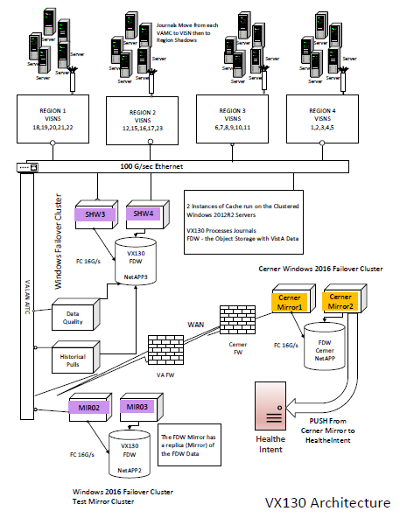
VX130 Infrastructure

Slide 25
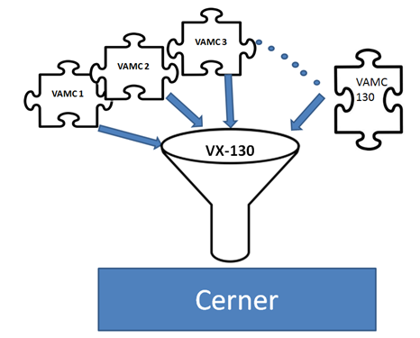
Summary
Mature software and architecture.
No VistA routines need to be altered in any way.
All data dictionary changes are monitored.
Shadowed VistA systems are used as data sources; no load is put on production systems.
Shadow systems funnel data from ALL VistA instances to a single instance for processing and/or reporting and migration.
Efficient use of resources for enterprise data extraction.
Mapping to other data structures becomes much easier. (HealtheIntent, SDA – HealthShare etc)
VX130

Slide 26

QUESTIONS?

Slide 27
VX130 Integration Reviewed by
Director: Jack Bates
Deputy Director: John Quinn
VX130
Augie Turano
Mike Baker
Leslie DeYoung
Justin Wilson
Rich Louis
Architecture
Trinity Hall
Laureen Kennedy
Margaret Gonsoulin

